Slide 1



HYDROGEN PEROXIDE EXPORT MARKET ANALYSIS
LECTURER DR : SARA BESHIR
COMPANY NAME: NEXT ACADEMY
ROUND 4

Slide 2






Our Team
Mariam Gamal
Mehany Mohamed
Basma Magdy
Seham Morsy
Anas Mahmoud

Slide 3


Agenda
7-Data Transformation & Feature Engineering
8-Data Modeling & Database Schema Design
9-SQL Analytics & Insights Extraction
10-Market Insights
11-DashBoard
12-Strategic Conclusions & Recommendations
1-Our Team
2-Project Overview
3-Project Objectives
4-Project Framework
5-Data Collection
6-DataCleaning& enhancement

Slide 4
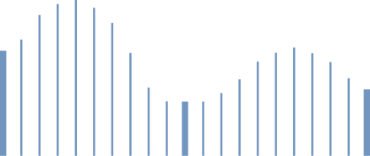

Project Overview
Project Origin: The project began with a fundamental question directed to an export team leader: "Why are we not exporting Hydrogen Peroxide ?"
To answer this question using actual trade data and complete quantitative analysis, rather than relying on qualitative opinions or generic recommendations.
Key Research Questions:
How can we identify the most attractive global export markets?
Who are our primary international competitors in these markets?

Slide 5
Data Sources: Raw, verified global trade data extracted from ITC Trade Map and UN Comtrade (specifically tracking HS Code 284700).
Technical Execution: Building a complete data analytics pipeline using a modern tech stack:
SQL & Python: For data extraction, querying, cleaning, and statistical modeling.
Excel: For baseline calculations and data auditing.
Power BI & Tableau: For creating interactive dashboards to visualize market attractiveness and competitor shares.
Key Findings

Slide 6
Project Objectives
Main Goal: To identify and rank the most attractive global export markets for Egyptian Hydrogen Peroxide (H₂O₂) using real, empirical trade data.
Key Objectives:
Market Identification: Pinpoint high-growth, high-volume importing countries within strategically close regions (Africa, Middle East, South Asia).

Slide 7
Competitor Analysis: Map out existing international competitors and determine their market shares.
Strategic Evaluation:Measure Egypt's competitive edge regarding export pricing, logistics, and preferential tariffs.
Data-Driven Decision: Replace intuition with a weighted scoring index to classify markets into clear priority tiers.

Slide 8
Project Framework
Main Question: What are the most attractive markets for Egyptian Hydrogen Peroxide exports?
Phase 1:
lobal Market OverviewFind the global market size, top 10 importing countries, and highest-growing regions (2020–2024).
Strategic Filter: Narrow down to Africa, Middle East, and South Asia for logistical proximity.
Phase 2:
Target Market Identification Filter countries by 4 pillars: Demand Volume, Growth Rate, Past Egyptian Exports, and Market Monopoly.Output: A short-list of 15 high-potential countries.

Slide 9
Phase 3:
Competitive LandscapeIdentify who the top international exporters are in these 15 countries and calculate their exact market shares.
Phase 4:
Comparative Advantage Compare Egypt against competitors based on Export Price, Shipping Distance/Time, and Trade Agreements
.Phase 5:
Export Attractiveness Index Build a weighted scoring model to rank markets into 3 simple categories: Priority, Long-Term Opportunity, or Low-Interest.

Slide 10



Data Collection
Data Collection & Sources
Primary Databases: Used ITC Trade Map and UN Comtrade to get actual global trade volumes and market growth data.
Competitor Analysis: Tracked international competitors to calculate their exact market share using global trade data.
Product Focus: Analyzed HS Code: 284700 (Hydrogen Peroxide) across 5 years (2020–2024) to see clear trends.

Slide 11



DataCleaning& enhancement
Handling Growth Outliers:
Calculated and applied the median for annual growth values
2.Regional Segmenting:
Added a custom Region column to group countries and facilitate the logistical filter (Africa, Middle East, South Asia).
3.Resolving Price Gaps:
Researched and filled missing Unit Values per Ton using reliable global trade benchmarks.
4. Imputing Missing Quantities:
Fulfilled empty quantity gaps using a calculated trade formula:
Quantity = total imported value / price
5. Market Structure Classification:
Added a Monopoly indicator column based on Supplier Concentration.
If the concentration ratio was greater than 0.5, the market was flagged as a monopoly.

Slide 12
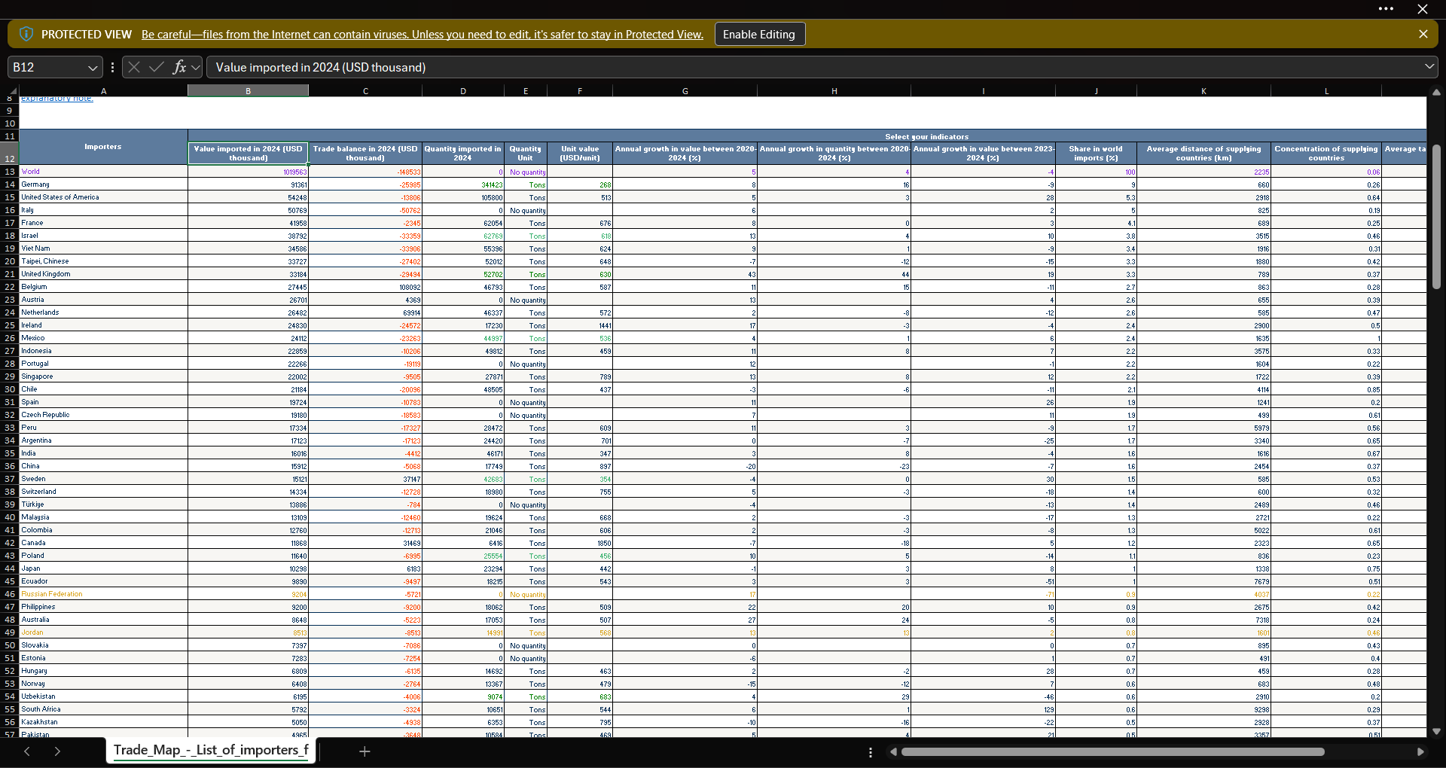
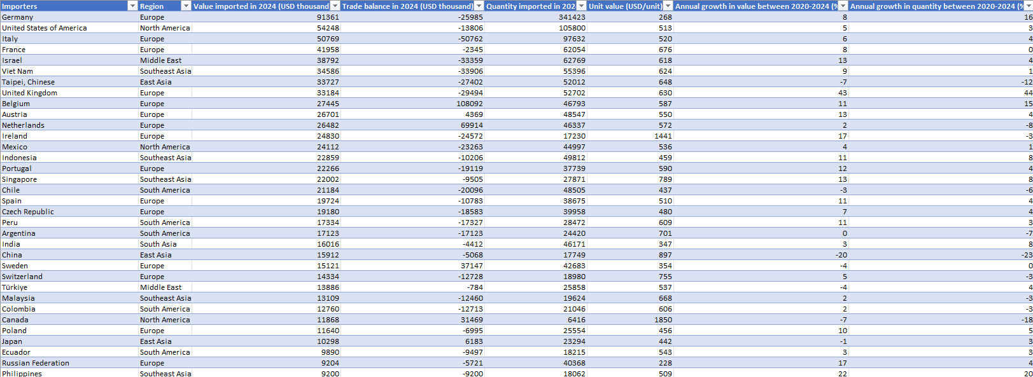

Slide 13
Data Transformation & Feature Engineering
Phase 2: Target Market Filtration & Shortlisting (The 15 Target Countries)
Regional Focus: Filtered the global database to Africa & the Middle East for optimal logistics and shipping costs.
Analyzed the top importing countries and the fastest-growing markets over the last 5 years.
Key Features Checked: Evaluated Egypt’s historical footprint and supplier concentration to by pass monopolies and find open markets.
Required countries to meet at least 2 out of 3 criteria to ensure data accuracy.
The Tools Used: Combined Excel Pivot Tables and Python (.nlargest()) to process the data.

Slide 14
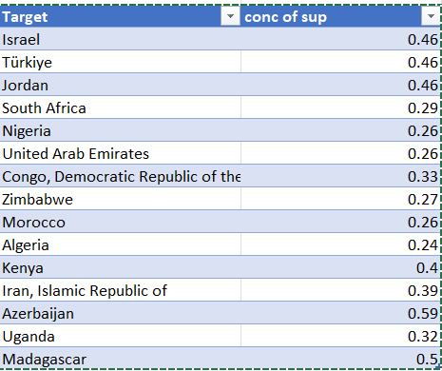

Slide 15
Data Transformation & Feature Engineering
Phase 3: Competitive Landscape & Market Share Extraction
In the next step of our data transformation, we focused entirely on the competitor matrix.
For each of our 15 selected target countries, we extracted the specific international competitors supplying them and calculated their exact market shares.
The goal was to identify which markets face intense global rivalry and which ones offer an open window for entry.
This entire matrix was aggregated and structured using Excel .

Slide 16
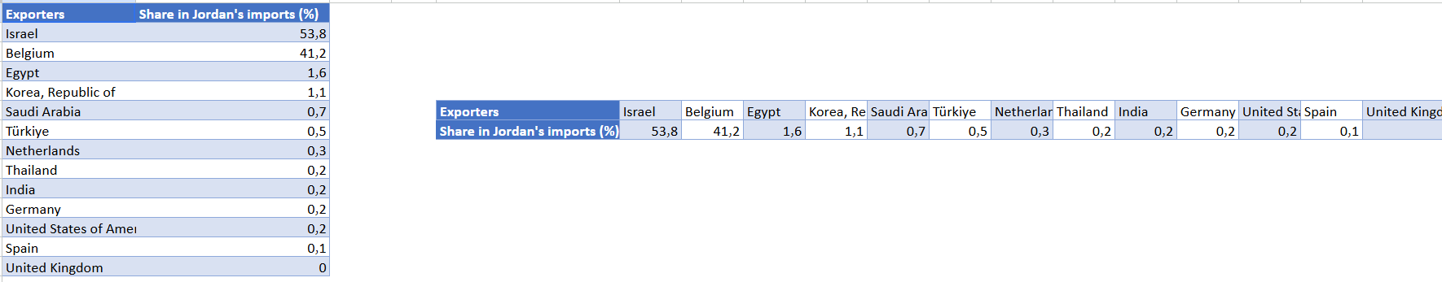
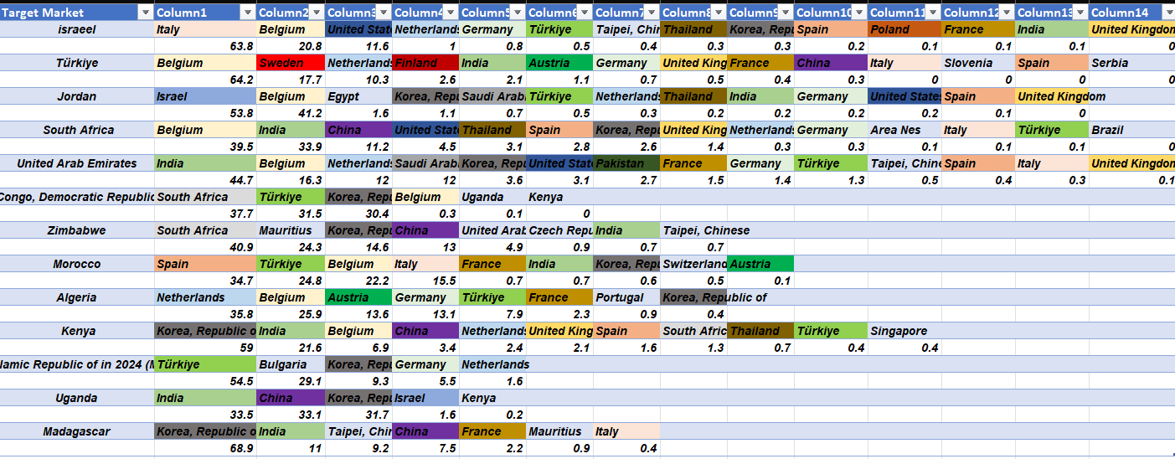
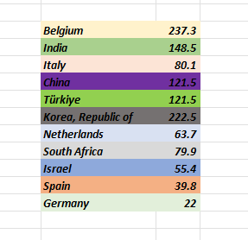

Slide 17
Data Transformation & Feature Engineering
Phase 4: Comparative Analysis & Feature Engineering
Found the top competing countries for our 15 target markets.
Used XLOOKUP to match and extract export prices, tariff rates, and shipping distances for Egypt vs. rivals.
The Final Output: Saved all of this clean data into a dedicated Competitive Analysis Table.

Slide 18
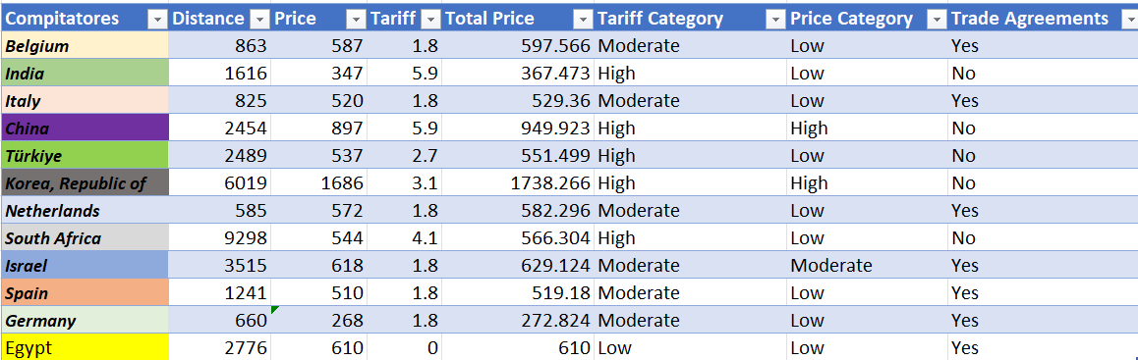

Slide 19
Data Transformation & Feature Engineering
Phase 5: The Weighted Scoring & Final Ranking Model
Central Decision Table: Gathered shipping distances, tariff rates, market sizes, and 5-year growth rates into one final table.
Weighted Scoring Model: Built an Excel model to score each metric based on its business importance.
Final Ranking Tiers: Automatically sorted the 15 countries into three clear groups: Priority, Long-Term, and Low-Interest opportunities.

Slide 20
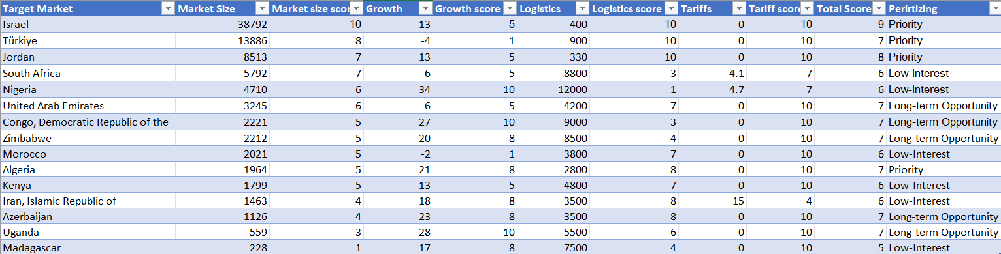

Slide 21
Data Modeling & Database Schema Design
This stage transitioned the project from isolated spreadsheets into an optimized data modeling
Key Assignment & Relational Mapping
To establish data integrity and link the tables logically, structural keys were

Slide 22
Data Modeling & Database Schema Design
Primary Keys (PK): Added unique IDs to every table (like ImporterID and TID) to keep rows clean and organized.
Foreign Keys (FK): Connected tables together so data could talk across different datasets.
XLOOKUP Mapping: Used Excel XLOOKUP to match up data fields and easily link main buyers to their target markets and competitors.

Slide 23
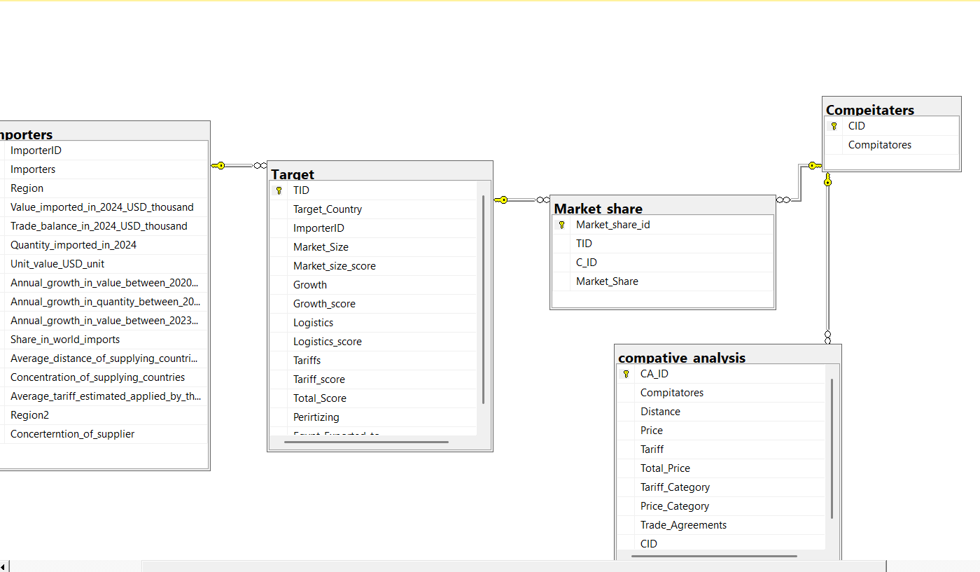

Slide 24
SQL Analytics & Insights Extraction
Custom SQL Scripting: Wrote native SQL queries from scratch to pull and analyze data for all 5 business phases.
Filtering (Phase 2): Created SQL Views (Top Importers, Most Dynamic, Actual Market) and combined them using UNION.
Rule Execution: Used CASE WHEN logic to automatically find and extract countries meeting >=2 core criteria.
Competitor Aggregation: Grouped and calculated the exact market shares for every rival company in our target countries.

Slide 25
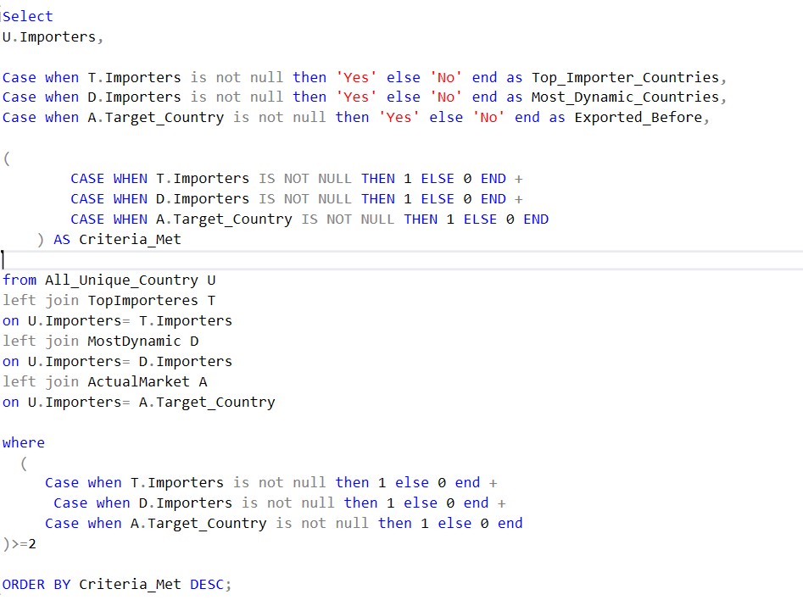
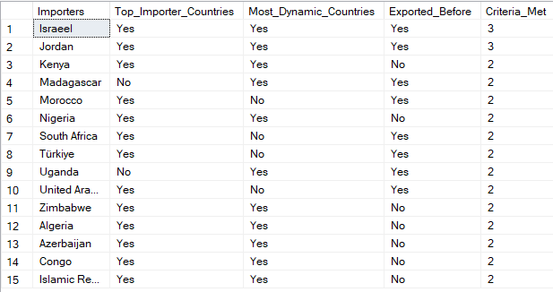

Slide 26
SQL Analytics & Insights Extraction
Competitor (Phases 3 & 4):
Wrote relational JOIN queries to find the top 10 global rivals and compare their prices, distances, and tariffs against Egypt.
Smart Tiering (Phase 5): Used SQL Window Functions (NTILE(5) OVER(...)) to automatically group countries into scores from 1 to 5 for size, growth, logistics, and tariffs.
Automated Final Ranking: Ran the final weighted scoring algorithm natively in SQL to instantly sort markets into Priority, Long-Term, or Low-Interest groups.

Slide 27
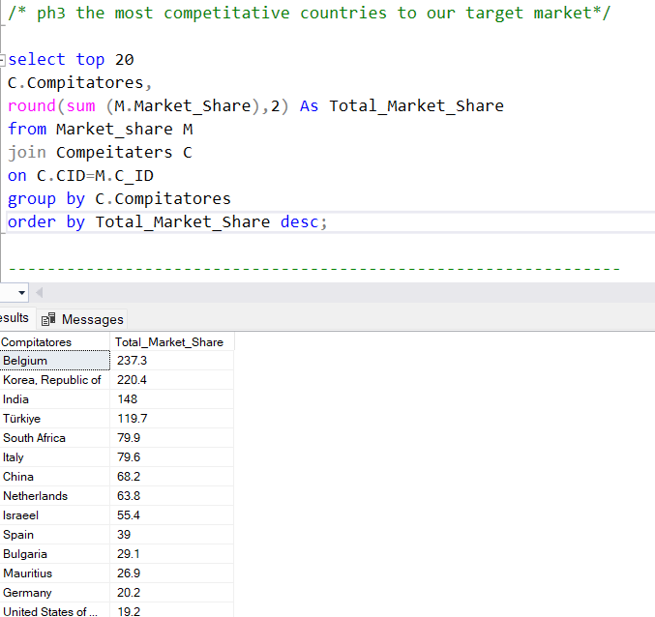
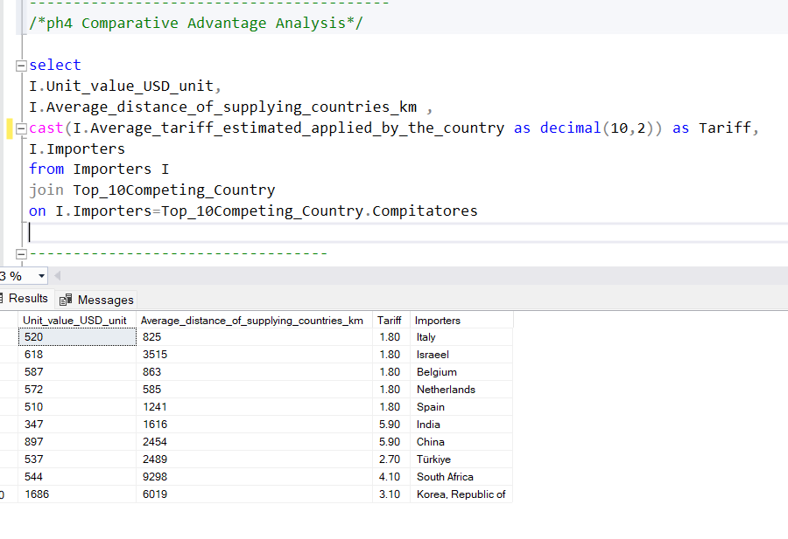

Slide 28
SQL Analytics & Insights Extraction
Used SQL Window Functions (NTILE(5) OVER(...)) to automatically group countries into scores from 1 to 5 for size, growth, logistics, and tariffs.
Automated Final Ranking: Ran the weighted scoring formula directly in SQL to instantly sort markets into Priority, Long-Term, or Low-Interest groups.

Slide 29
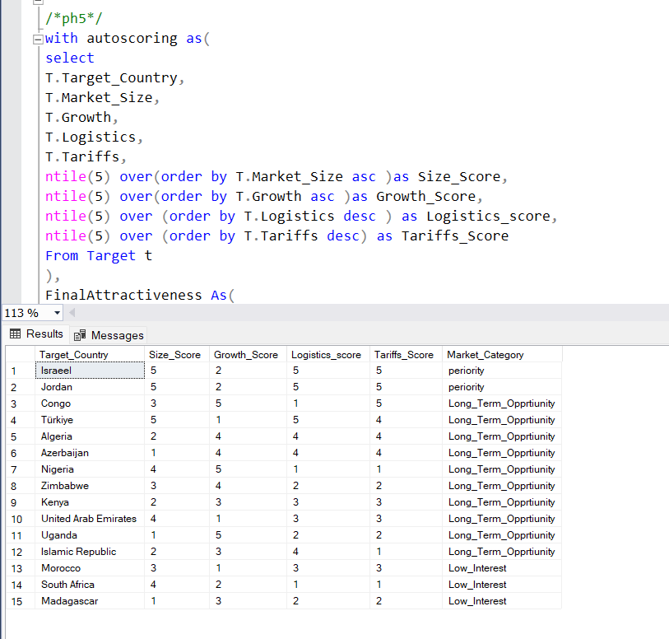

Slide 30
Market Insights
Global Market Size: Found the total global trade value for Hydrogen Peroxide (H2o2) in 2024.
Top Importers: Led by Germany ($91.3M), the United States ($51.6M), and Italy.
Growth Clusters: Identified the fastest-growing markets, with Africa and the Middle East showing highly favorable growth and import trends.
Market Concentration: Checked supplier control per region to flag monopoly structures (where a small group holds over 50% market concentration).

Slide 31
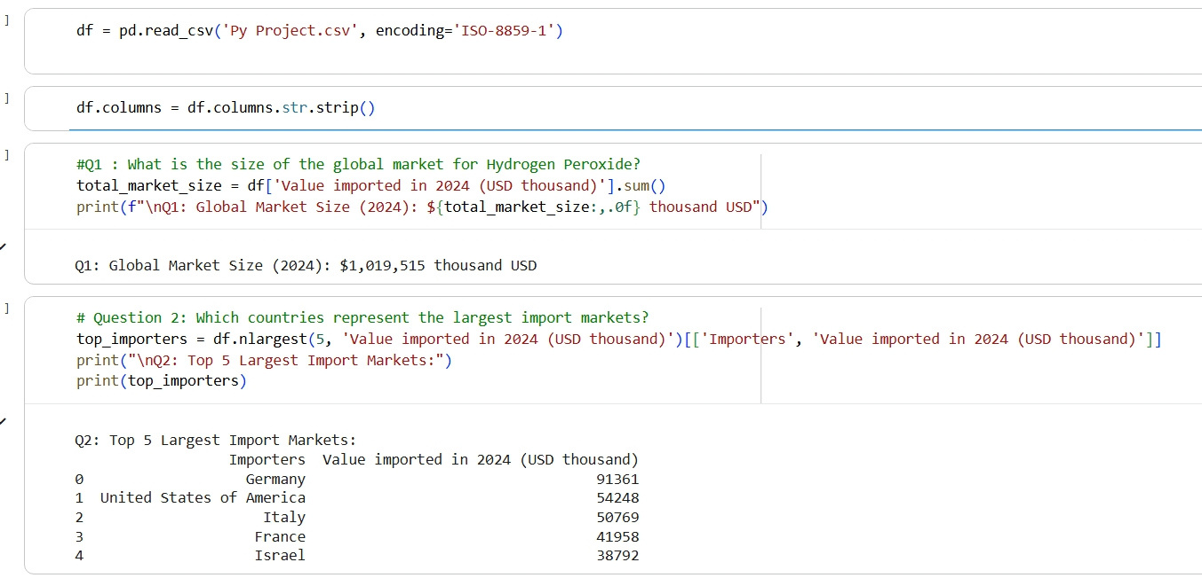
Market Insights phase1

Slide 32
Phase 2 &3
Target Market ph2 we fount the matched criteria in those countries Israel
Türkiye
Jordan
South Africa
Nigeria
United Arab Emirates
Congo (Democratic Republic of the)
Zimbabwe
Morocco
Algeria
Kenya
Iran
Azerbaijan
Uganda
Madagascar
Phase 3: Top Global Competitors in Target Markets Belgium
India
Italy
China
Türkiye
South Korea (Republic of Korea)
Netherlands
South Africa
Israel
Spain
Germany

Slide 33
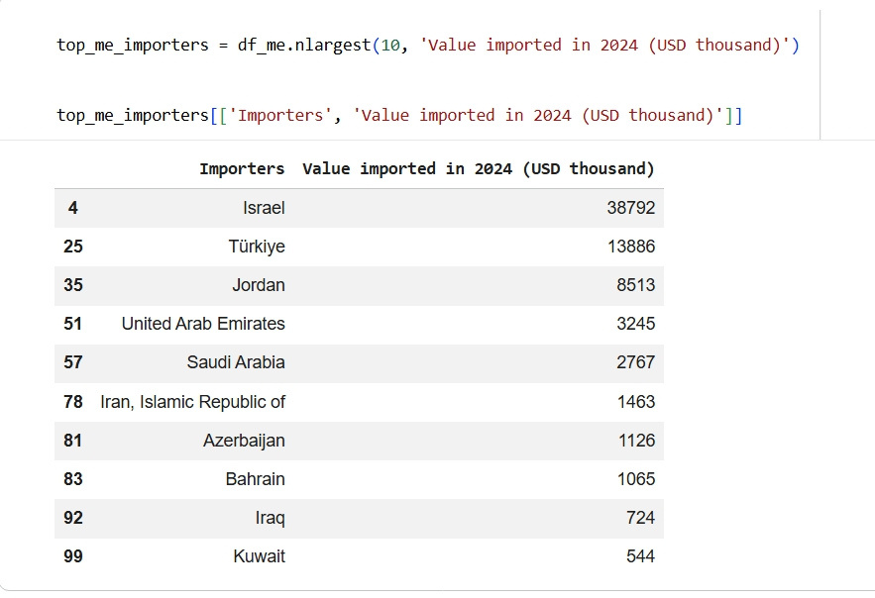
Market Insights phase 2

Slide 34
Market Insights phase 5
Priority Group: Israel and Jordan (Perfect Size, Logistics, and Tariffs—immediate targets).
Long-Term Opportunities: Congo, Türkiye, Algeria, Azerbaijan, Nigeria, Zimbabwe, Kenya, UAE, Uganda, and Iran (High growth/size, but facing tougher tariffs or competition).
Low-Interest Zones: Morocco, South Africa, and Madagascar (Lowest scores due to weak growth, high tariffs, or poor logistics).

Slide 35
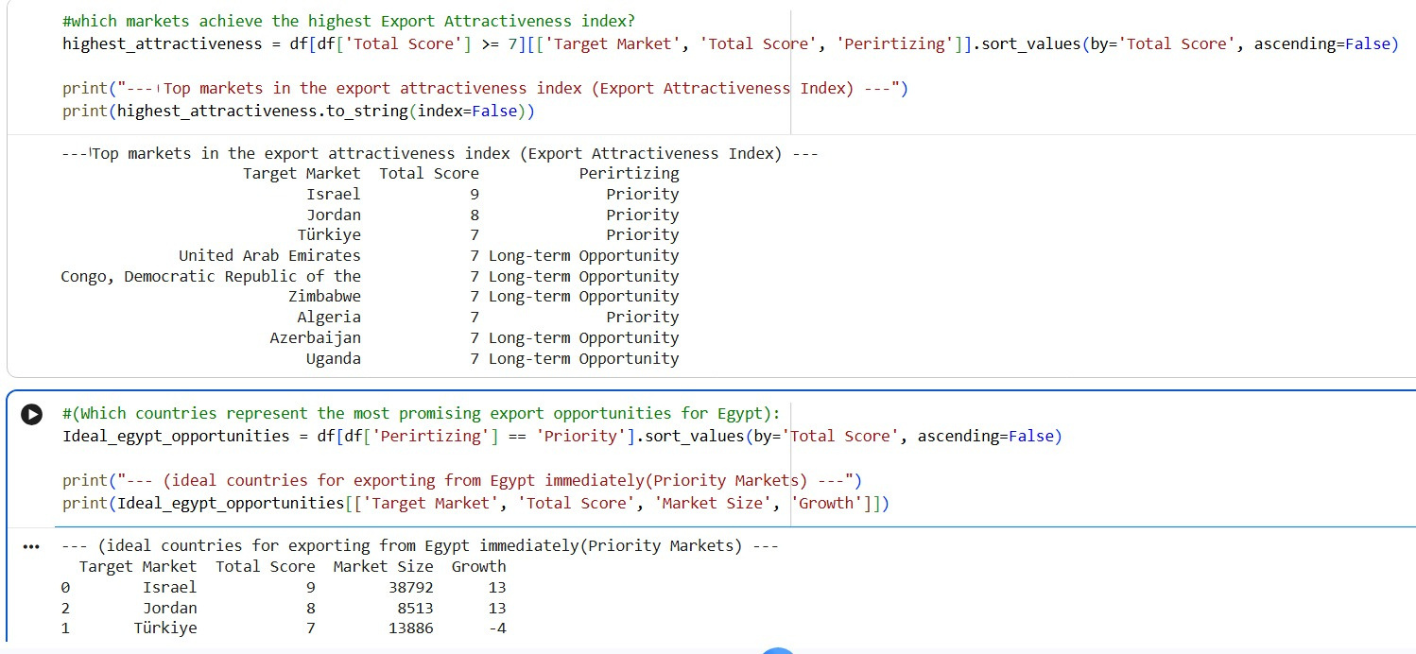
Market Insights Phase 5

Slide 36
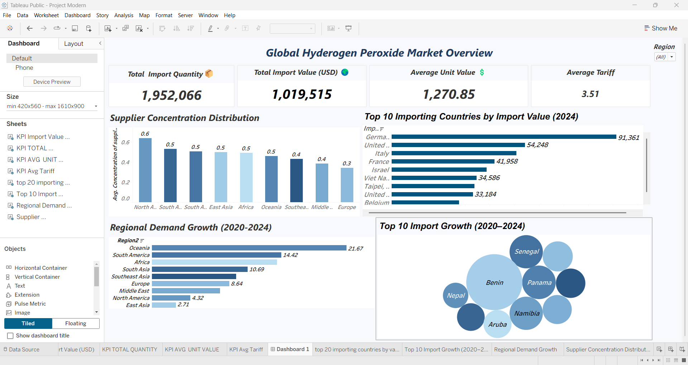
DashBoard
Tableau phase1

Slide 37
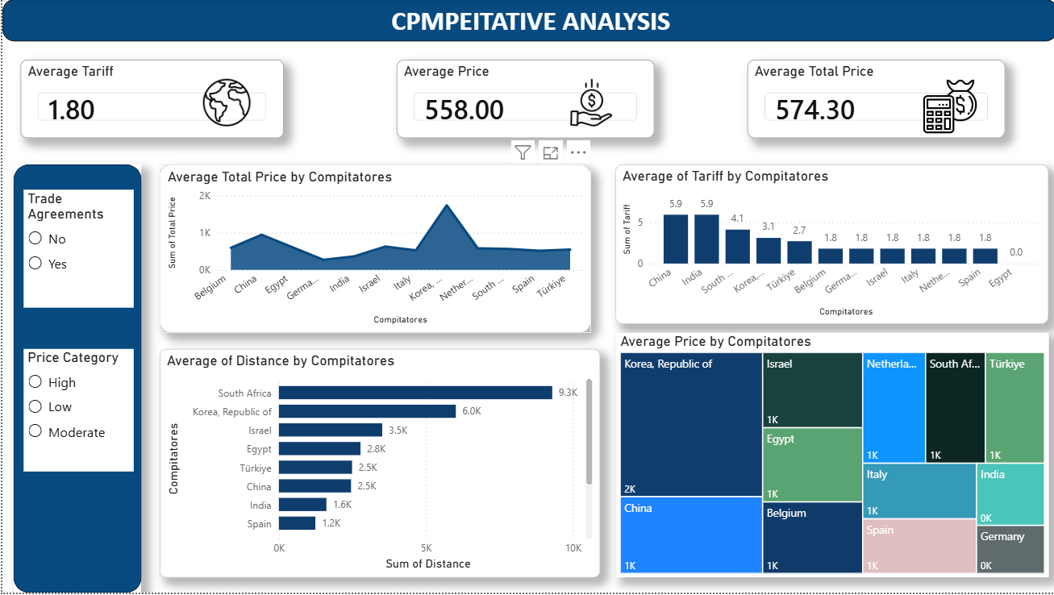
DashBoard Power BI phase4

Slide 38
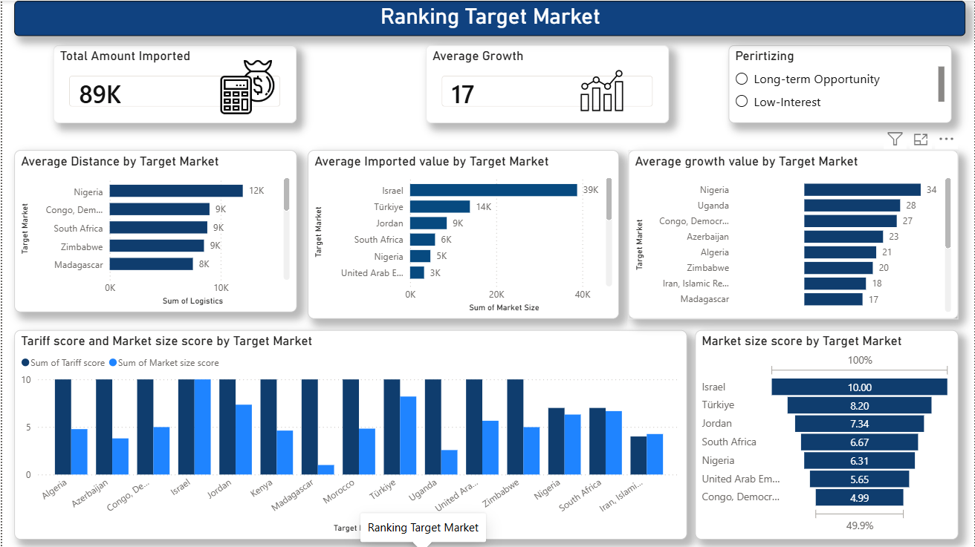
DashBoard Power BI phase5

Slide 39
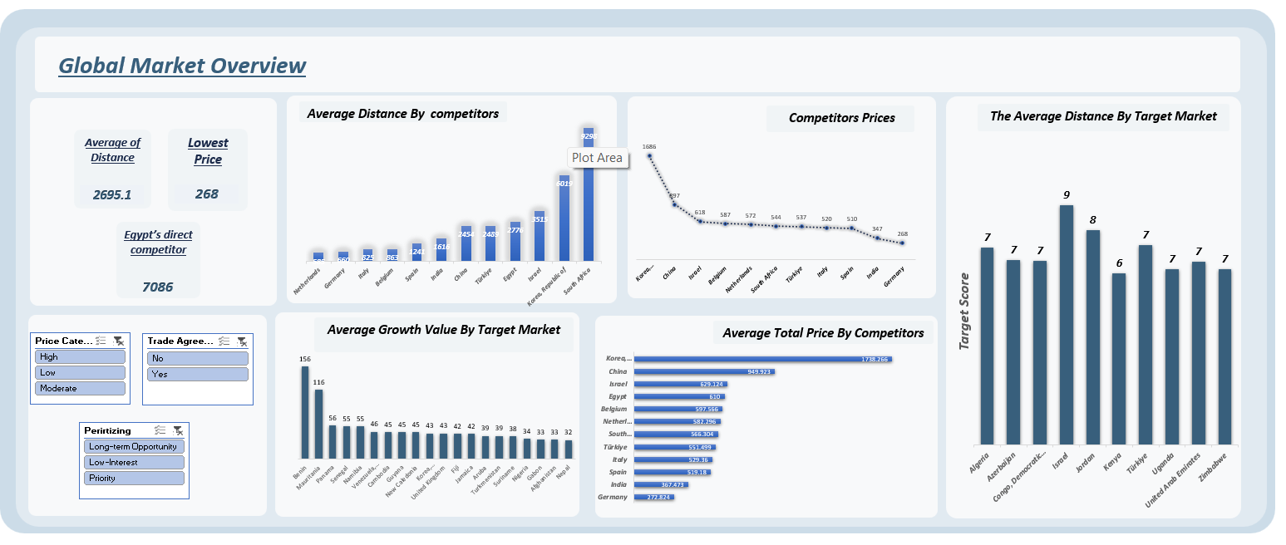
DashBoard Excel

Slide 40
Strategic Conclusions & Recommendations
Proven Export Success: Egypt already exports Hydrogen Peroxide successfully, proving our quality meets global standards.
Immediate Targets (Short-Term): Jordan and Türkiye are the best choices right now due to large market sizes and easy logistics.
Future Targets (Long-Term): Congo, Kenya, Algeria, Uganda, and the UAE offer great growth and massive scale for the future.
The COMESA Advantage: Shipping to Kenya and Uganda means 0% tariffs under the COMESA agreement, beating global rivals on cost and speed.
Big Opportunity: Entering these growing markets will significantly boost Egypt's export revenues.

Slide 41




Q&A Session?

Slide 42

THANK YOU!

